Slide 1

GIT AND GITHUB #CREATING BRANCHES
By:
Babirye Sandra Ruth

Slide 2

Introduction to Git and GitHub
Git: A distributed version control system.
GitHub: A web-based platform for hosting Git repositories.
Purpose: collaboration, project and team management, task assignment, etc

Slide 3

Collaborative Development with GitHub
Fork the repository
Clone on the local computer
Create & Select branch to work on
Edit
Commit
Push the edits to GitHub
Create a pull request
Changes are merged
“GitHub work cycle from fork to merge”

Slide 4
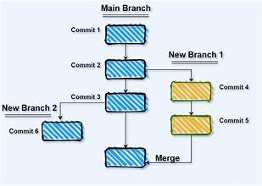
Overview of branches on GitHub
Definition: A branch is a separate line of development.
Purpose:
Enhanced collaboration
Simplified code reviews
Safe experimentation
Feature enhancement
Organized workflow
Analogy: Think of branches like "save points" in a game.

Slide 5
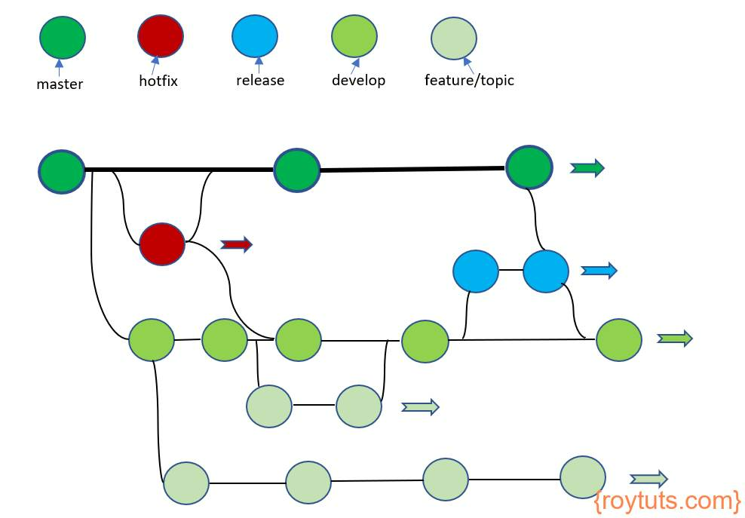
Examples of essential branches
Main/Master: Stable and production-ready.
Development (develop): Latest development changes and integration of new features.
Feature (feature/<name>): Individual new features or experiments.
Hotfix (hotfix/<name>): Urgent fixes to be deployed immediately.
Release (release/<version>): Preparing for a new release version.

Slide 6
Basic Git Commands for Branching
git branch / git branch –r - List branches.
git branch <branch-name> - Create a new branch.
git checkout <branch-name> - Switch to a specific branch.
git checkout -b <branch-name> - Create and switch to a new branch.
git merge <branch-name> - Merge a branch into the current branch.
git branch -d <branch-name> - Delete a branch.
NB: Always use the git cheat sheet for more commands

Slide 7
Creating branches in the terminal demo
Keys steps:
Identify the git hub repository you want to contribute to
Fork the git hub repository
Clone the repository
Navigate to the cloned repository
Create a branch
Switch to the selected branch

Slide 8
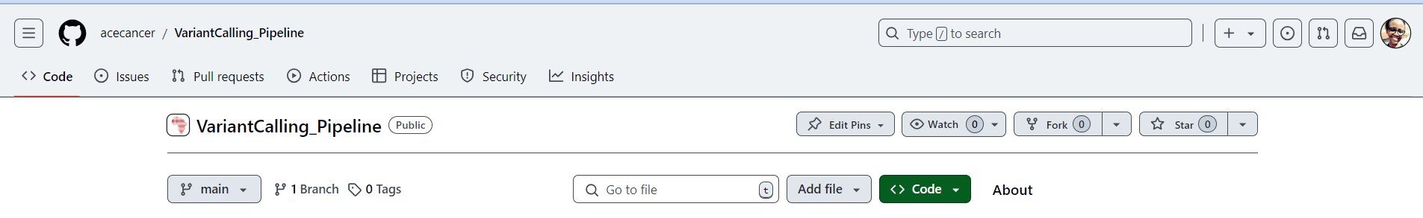

Step by step guide
Step1: Fork a Repository on GitHub
Navigate to the repository you want to work on.
Click the "Fork" button in the top-right corner to create a personal copy of the repository in your GitHub account.

Slide 9
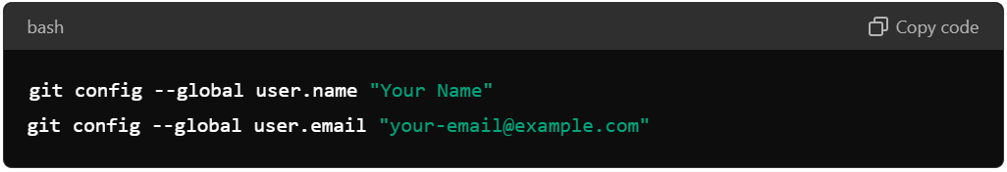
Step by step guide
Step2: Configure Git (Set Up Identity): Before you start using Git, you need to configure your username and email address. These details are associated with your commits.

Slide 10
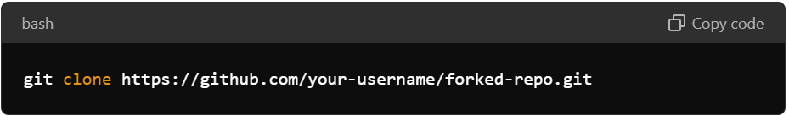
Step by step guide
Step3: Clone the Forked Repository to Your Local Machine
Open your terminal or Git Bash.
Run the command
Replace the ‘your-username’ with yours and the ‘forked-repo.git’ with the repository name

Slide 11
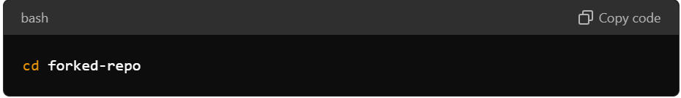
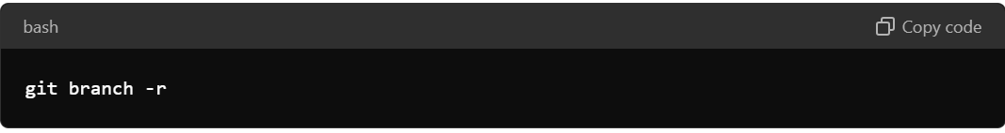
Step by step guide
Step4: Navigate to the Cloned Repository:
Change the directory to your cloned repository
Step5: List all branches NB: The currently active branch with be represented with “*”

Slide 12
Step by step guide
Step6: Create a new branch
Command: git branch <branch name>
Step 7: Alternatively if you want to create a branch from another branch as the base
For example, to create a feature-login branch based on develop without first checking out develop:
command: git checkout -b feature-login develop
Or
commands:
git checkout develop
git pull – pull the latest changes
git checkout –b future-login

Slide 13
Other basic key commands
To check the status for the repository – git status
To add the changes to the staging area- git add <file name> or git add . (all files)
To commit changes to the repository – git commit –m “commit message”
To push changes to GitHub – git push origin <branch name>
To pull changes from GitHub – git pull origin <branch name>
To delete a local branch – git branch –d <branch name>
To view remote repositories – git remote –v

Slide 14
Creating branches on GitHub demo
Live Demonstration: (https://github.com/acecancer/VariantCalling_Pipeline)
Create a branch, make changes*, commit*, push* to GitHub.
Open a Pull Request, review, and merge.*
Encourage Participation: Attendees can follow along on their devices.
NB: (This is being done after forking the git hub repository )

Slide 15

Q&A and Discussion
Open Floor: Questions, further explanations, and interactive discussion.

Slide 16
Qn1: How do I retrieve changes made on original repository in my repository
Response
Add upstream repository
command: git remote add upstream https://github.com/original-owner/original-repo.git
2. Fetch the latest changes from the upstream repository
command: git fetch upstream
Switch to the branch you want to update
command: git checkout <branch name>
4. Merge the upstream changes into your local branch
command: git merge upstream/<branch name>
5. Push these changes to your forked repository : git push origin <branch name>

Slide 17
Qn2: Retrieving a deleted branch
Response: Git hub usually keeps a reference (commit SHA) to the deleted branches that can be retrieved by running command: git reflog
If the branch you deleted is found then you can restore it using command:
git checkout –b <branch name> commit-hash

